Slide 1
V-Menu
Team Two

Slide 2

TEAM Members
Matthew Boyette – Lead Developer
David Hughes – Lead Designer
William Mejia – Developer
Demetrius Myers – Developer
Slaven Popadic – Developer

Slide 3
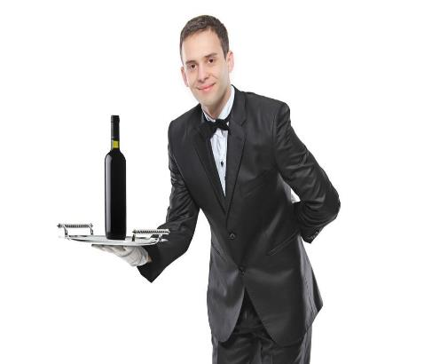
Why v-menu
Convenience
Speed
Control
Customer Satisfaction
Efficient
Modern
Privacy

Slide 4
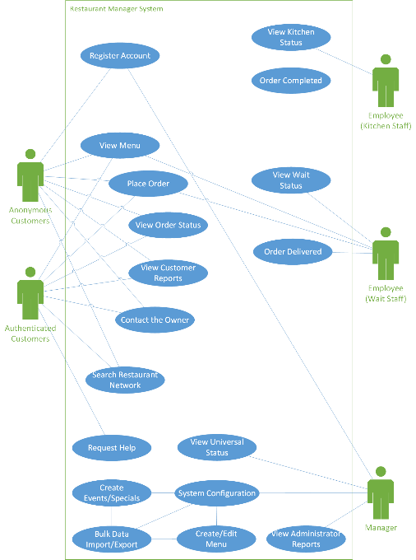

Slide 5
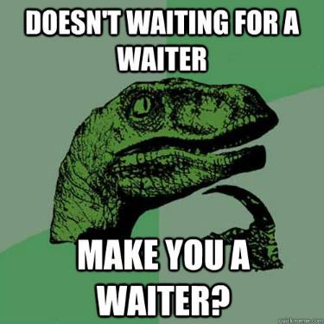


Slide 6
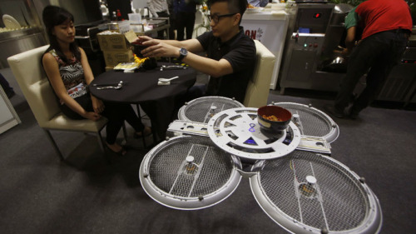
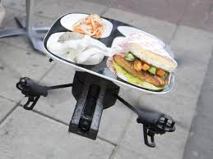
A system that is able to move efficiently with the times.
Drone servers?

Slide 7
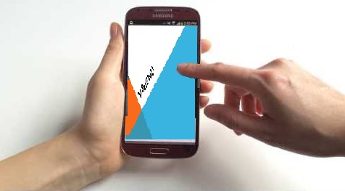
ALL restaurants one APP

Slide 9
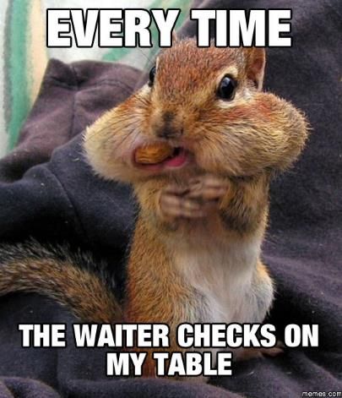

Slide 11
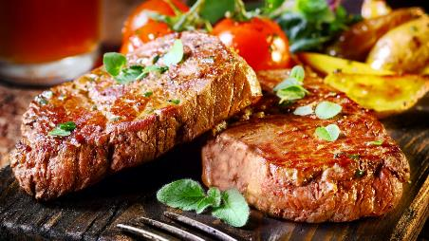
Convenience & Speed
Your order history is available to you and you can simply
reorder your favorite item in a couple of clicks !!
Fast and easy
for
Customers
And
Staff

Slide 12


Control & customer satisfaction
The customer is in full control of the order and ordering process

Slide 13


Slide 14


Efficient & modern

Slide 16

Privacy

Slide 17
Non-Functional Requirements
· 8 letter username for users
· At least 5 users able to be logged in to the system
· Keep track of concurrent and multiple orders
· Supports popular browsers (IE, Chrome, Firefox)
· Passwords (At least 1 Capital, 1 number, 8 characters)
· Recovery options for Data
· Maintenance
· Hidden Items, separate database
· Account Security (Usernames and Passwords)

Slide 18


